Slide 1
Docker Compose
When your application needs more than one container, managing them manually can be difficult. For example, a web application might need one container for the web server and another for the database.
Docker Compose is a tool provided by Docker that helps you define and manage multi-container applications.
Instead of running containers manually with long docker run commands, you describe your application’s services, networks, and volumes in a single YAML file (usually docker-compose.yml).
YAML- Ain’t Markup Language" to emphasize that YAML is more about data serialization (like JSON or XML), not just a markup language

Slide 2
Purpose of Docker Compose
Simplifies Multi-Container Apps
Many real-world applications need more than one container (e.g., a web app + database + cache).
Compose lets you define them all in one file and start them together.
Centralized Configuration
Instead of remembering many docker run commands, you define everything (images, ports, environment variables, volumes, networks) in one YAML file.
Environment Management
Easily define dev, test, and production environments.
You can scale services (e.g., multiple web app containers) with a single command.
Networking Made Easy
Compose automatically creates a private network for your containers so they can talk to each other by name (service name).
Reproducibility
Anyone with the YAML file can spin up the same setup consistently with docker-compose up.

Slide 3
docker-compose.yml File
A docker-compose.yml file is a configuration file that defines:
What containers (services) to create.
How they should work together (like connecting WordPress to MySQL).
Settings for each container (such as ports, environment variables, etc.)
This file is written in YAML format, which is a simple, human-readable way to structure data.

Slide 4
Basic docker-compose.yml File
Step 1: Create a Folder
Go to your desktop or any folder you prefer.
Right-click and select New Folder.
Name the folder my_docker_project.
Step 2: Open a Text Editor
Open Visual Studio Code, Notepad, or any other text editor.
Create a new file.
Step 3: Write the YAML Configuration
Here’s a simple example of a docker-compose.yml file for WordPress and MySQL:

Slide 5
4. docker-compose.yml file to run WordPress with a MySQL database
depends_on:
- db
volumes:
- wordpress_data:/var/www/html
db:
image: mysql:5.7
container_name: mysql
restart: always
environment:
MYSQL_ROOT_PASSWORD: rootpassword
MYSQL_DATABASE: wordpress_db
MYSQL_USER: wp_user
MYSQL_PASSWORD: wp_pass
volumes:
- db_data:/var/lib/mysql
volumes:
wordpress_data:
db_data:
services: defines containers (WordPress, MySQL).
environment: passes config (DB connection info).
ports: maps local port to container port.
depends_on: ensures WordPress waits for MySQL.
volumes: keeps your data safe across restarts.
wordpress_data stores WordPress files.
db_data stores database files.
version: '3.8'
services:
wordpress:
image: wordpress:latest
container_name: wordpress
restart: always
ports:
- "8082:80"
environment:
WORDPRESS_DB_HOST: db:3306
WORDPRESS_DB_USER: wp_user
WORDPRESS_DB_PASSWORD: wp_pass
WORDPRESS_DB_NAME: wordpress_db

Slide 6
5. Saving the File
Save the file as docker-compose.yml.
Place it in the my_docker_project folder.
6. Running the Setup
Step 1: Open Command Line
Open PowerShell or Command Prompt.
Navigate to the my_docker_project folder:
cd path_to_my_docker_project
Step 2: Start the Containers
Run:
docker-compose up -d

Slide 7
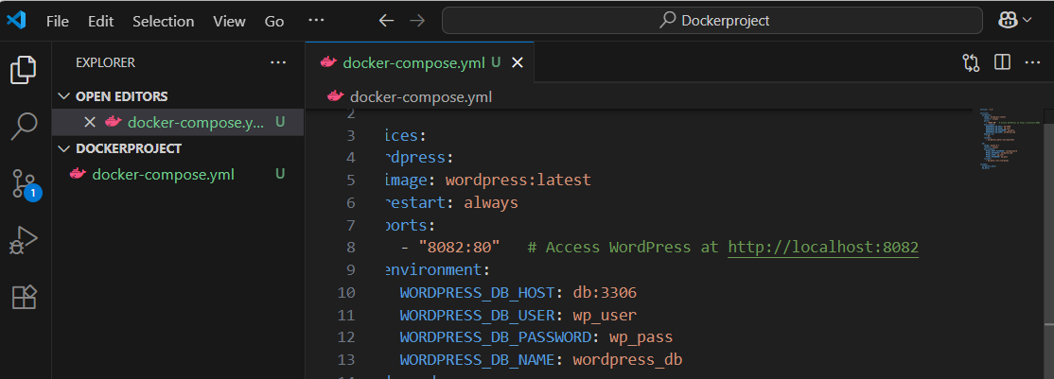
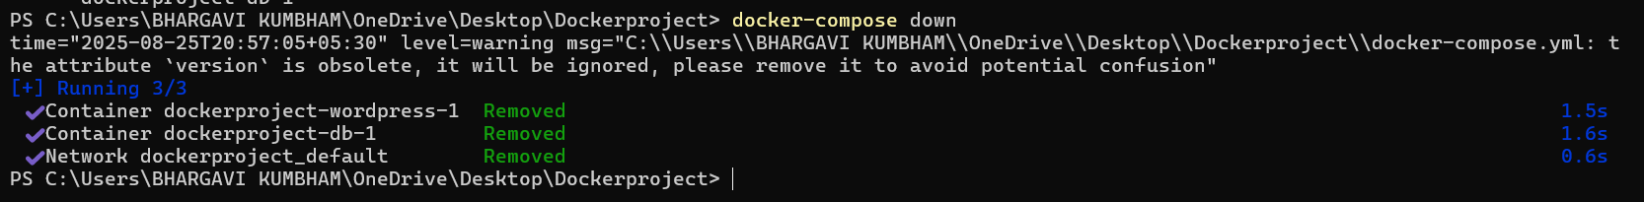
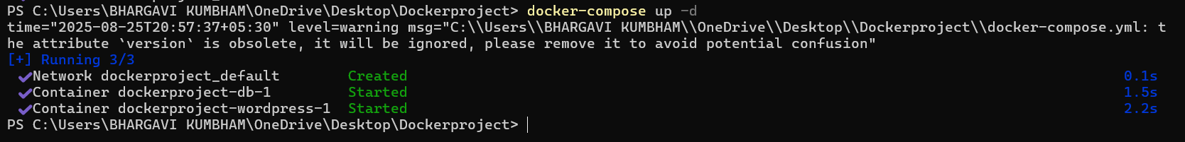
have the same port for another then change it
then do docker compose down
Run: docker-compose up -d

Slide 8
7. Accessing the Application
Open your web browser.
Go to docker-compose up -d
Follow the WordPress setup wizard to complete the installation:
Site Name.
Admin Username and Password.
Email Address

Slide 9
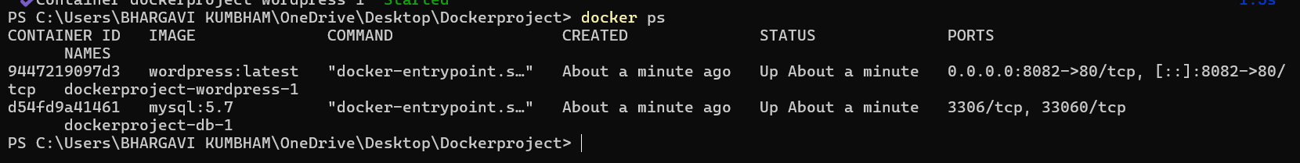
docker ps Verify containers of wordpress and mysql 5.7

Slide 10
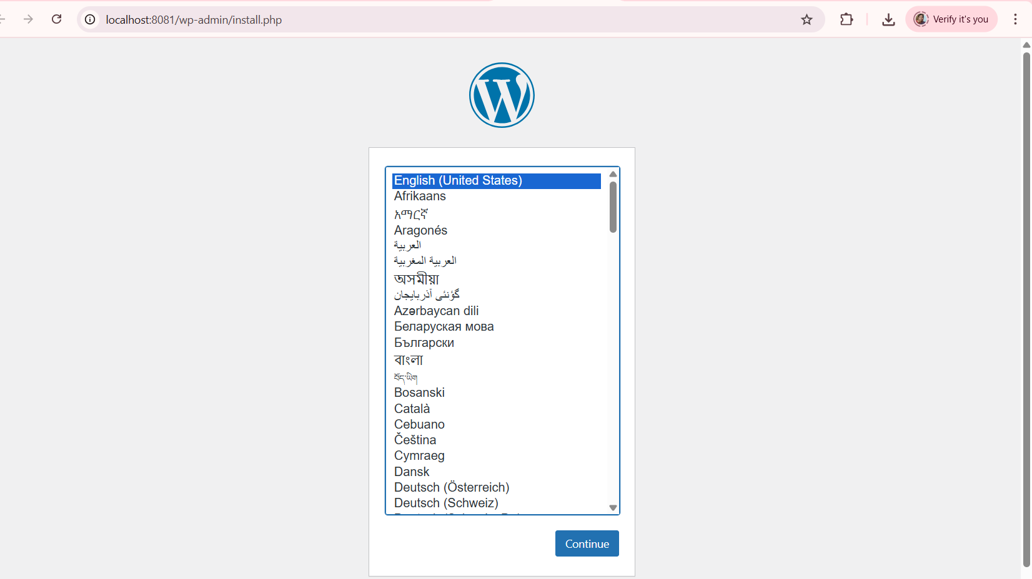
Open browser: http://localhost:8082 → You should see the WordPress setup page

Slide 11
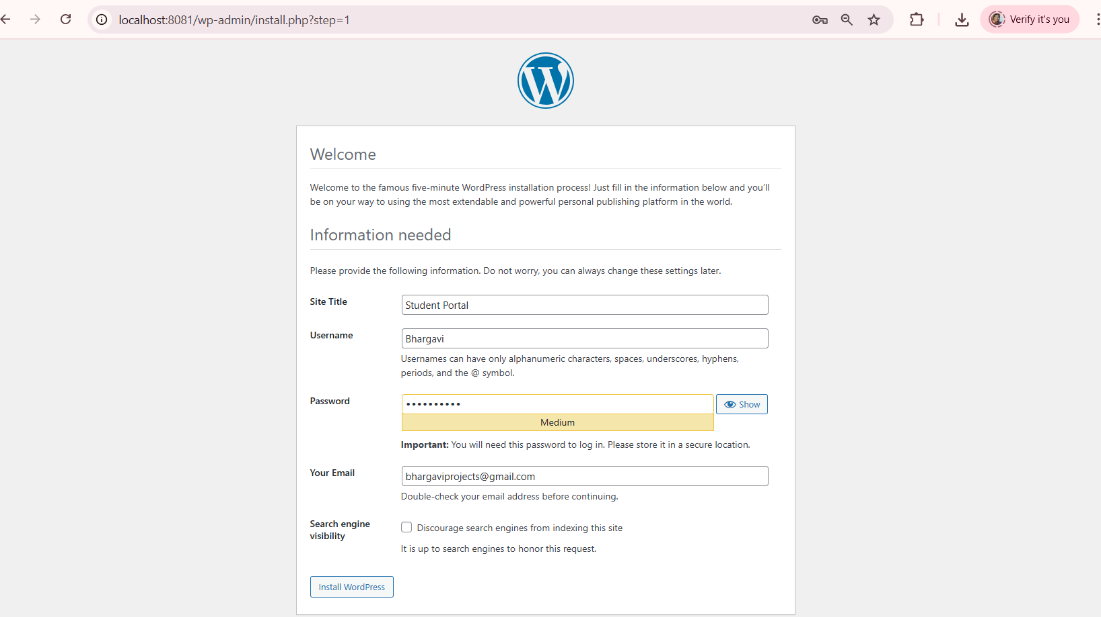
sitetitle,user name,password,your E-mail and click on install wordpress

Slide 12

click on login

Slide 13
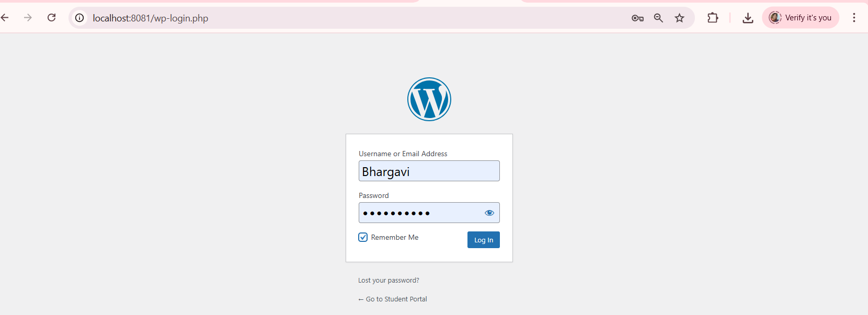
Login page

Slide 14
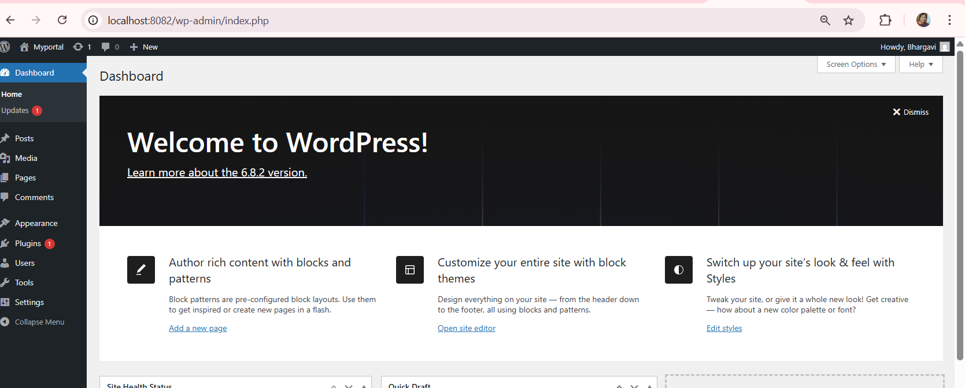
opens the wordpress

Slide 15
What is --scale in Docker Compose?
The --scale option in Docker Compose is used to tell Docker how many copies (replicas) of a service you want to run at the same time.
--scale = Run multiple instances of the same service, all managed by Docker Compose.

Slide 16
To scale the container docker-compose up --scale docker-compose up --scale web=2 -d
getting an error, That happened because in your docker-compose.yml, the service name is wordpress, not web. There is no service called web → hence the error.

Slide 17
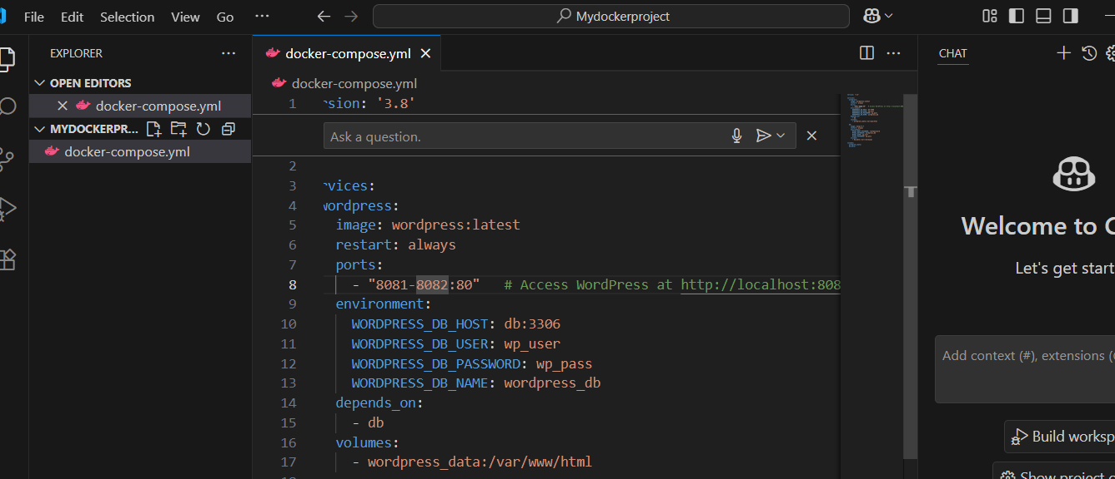
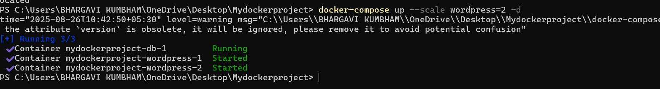
Compose starts 1 container of wordpress.change the ports -8082-8083 But if you run: docker-compose up --scale wordpress=2 -d

Slide 18
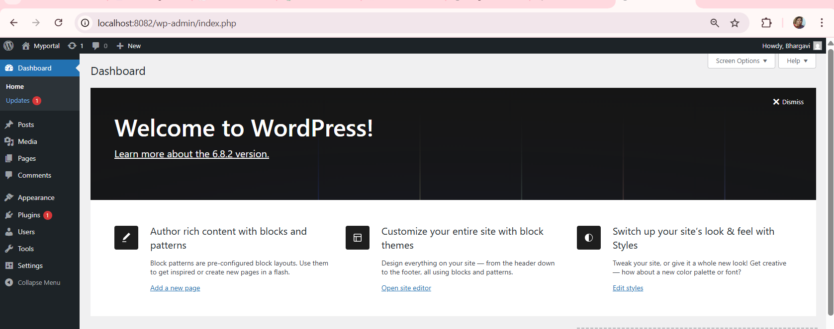
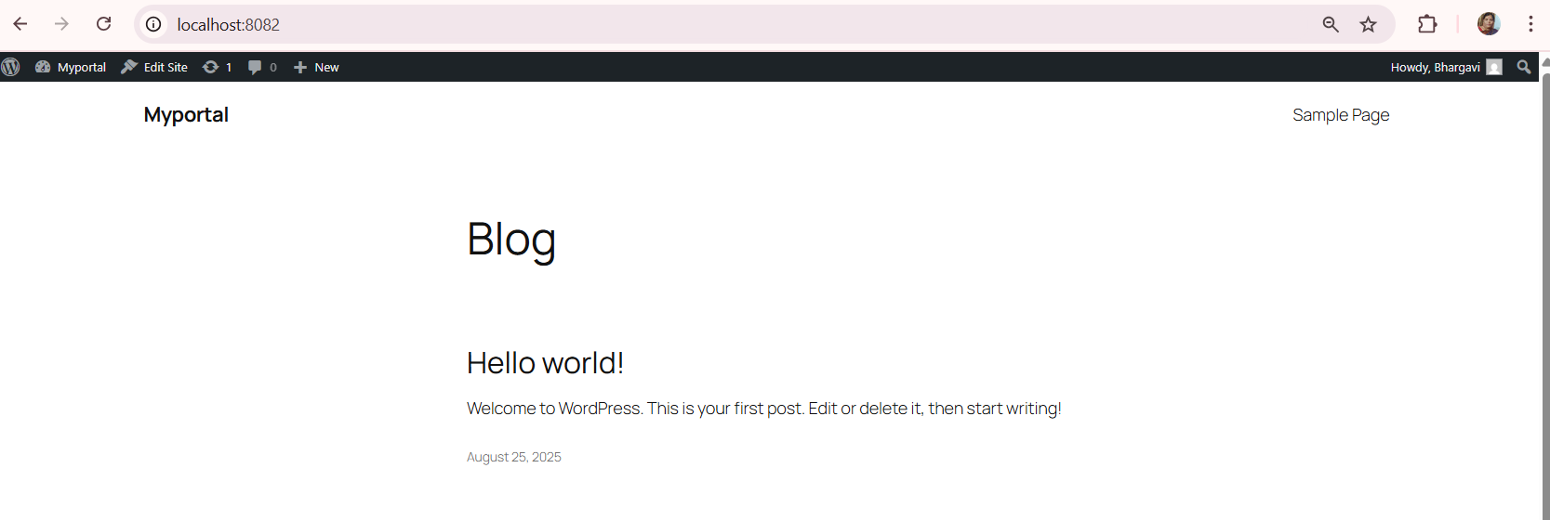
Open in your browser: http://localhost:8082 http://localhost:8083

Slide 19
Try this
A homepage (Home page you created).
A menu with navigation.
A theme for design.

Slide 20
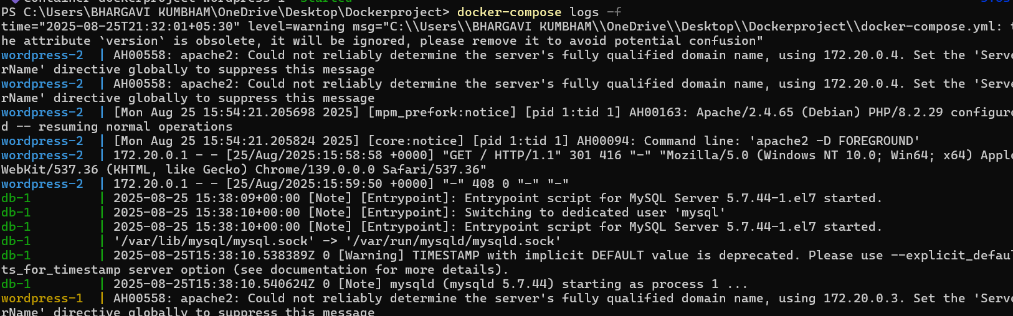
docker-compose logs -f Apache started. MySQL should say MySQL init process done. Ready for start up.

Slide 21
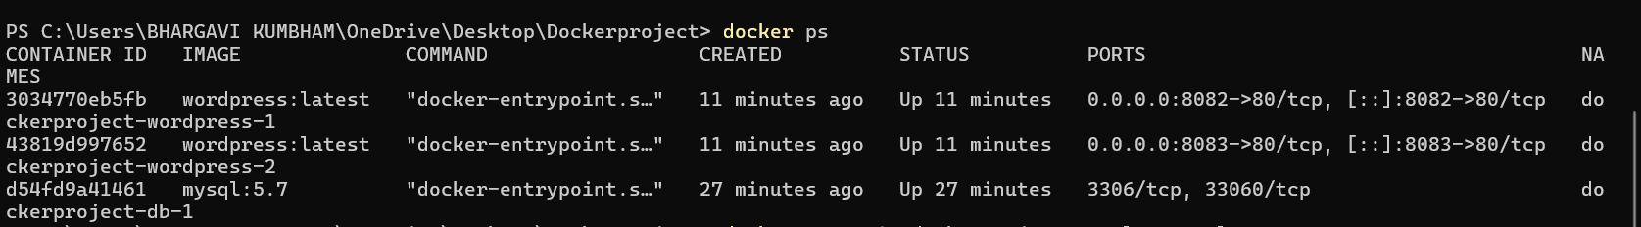
docker ps will come to know the containers names
MySQL container name → dockerproject-db-1
WordPress container names →
dockerproject-wordpress-1
dockerproject-wordpress-2

Slide 22
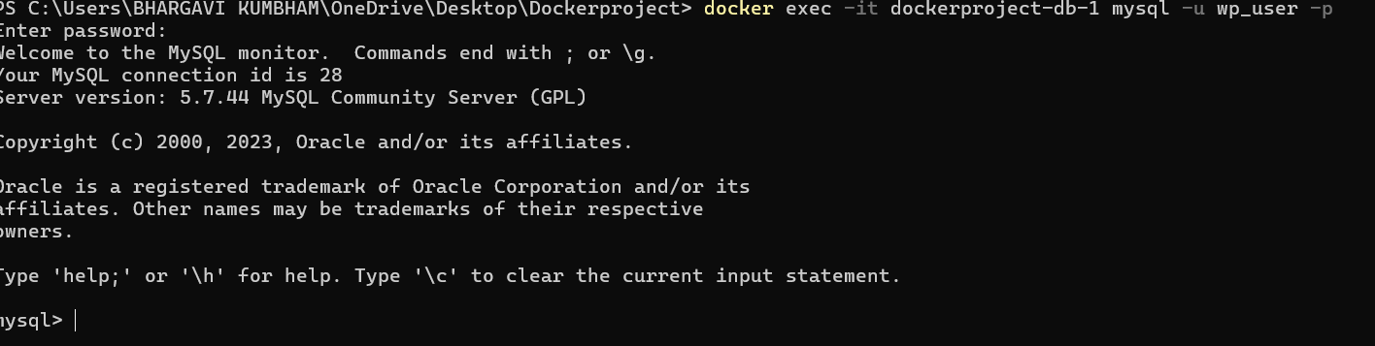
connect into MySQL container docker exec -it dockerproject-db-1 mysql -u wp_user -p asks the password take from docker-compose.yml file i.e wp_pass

Slide 23
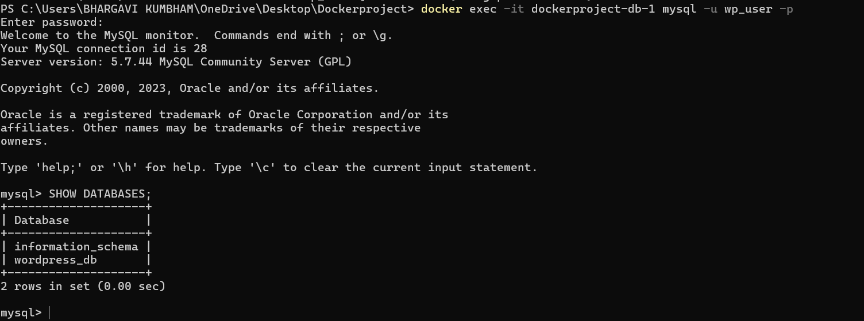
See which databases exist

Slide 24
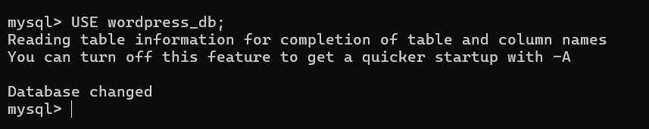
Switch to your WordPress database:

Slide 25
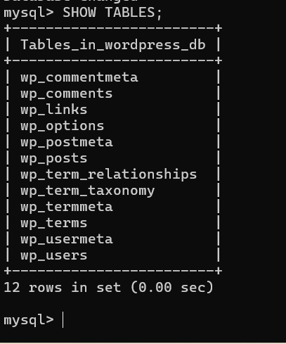
See all tables inside

Slide 26
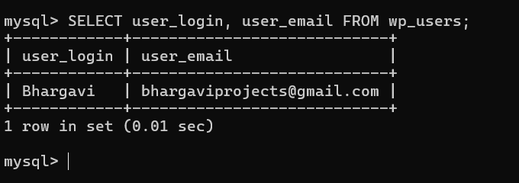
SELECT user_login, user_email FROM wp_users;

Slide 27

Exit MySQL

Slide 28
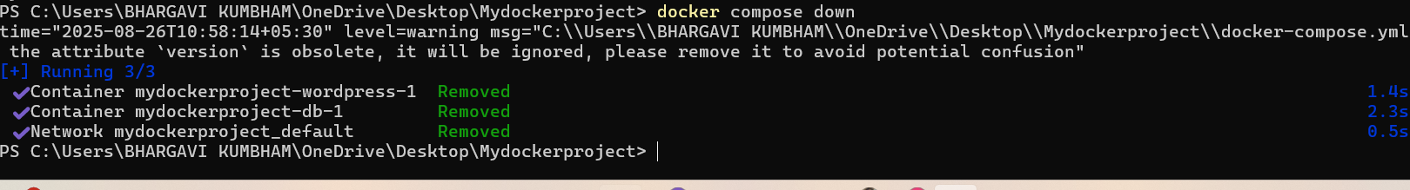
Remove containers
docker compose down

Slide 29
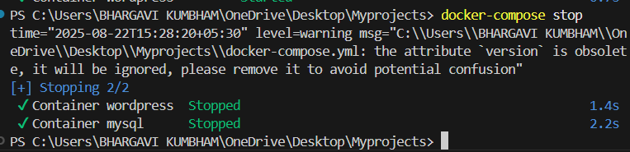
To stop the containers without removing them: docker-compose stop

Slide 30
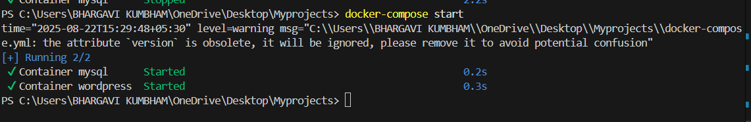
Start Again To restart the containers: docker-compose start

Slide 31
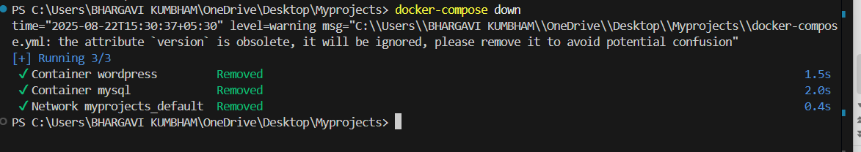
Remove Containers To stop and remove everything: docker-compose down

